Slide 1
Driver Attention Detection
Team Phoenix
Arpitha Gurumurthy, Surabhi Govil, Gayathri Pulagam

Slide 2
List of Contents
Introduction
Dataset
Transfer learning with VGG
Model evaluation
Machine learning pipeline using Apache Airflow
Learnings and improvements
Conclusion

Slide 3
Introduction
According to the CDC motor vehicle safety division, one in five car accidents is caused by a distracted driver
A study found that, traffic holdup at signals has increased in the recent years due to distracted driving
Distracted driving includes usage of mobile phones while driving, operating radio, talking to fellow passengers etc.
To combat these issues, we tried to come up with a solution wherein unsafe distracted driving could be recognized
We used various CNN based models to classify distracted driving

Slide 4
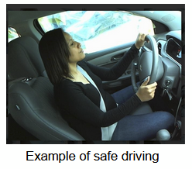
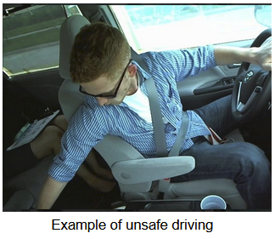
Dataset
We used State Farm Data available on Kaggle for our project
The images are divided into train (25k images) and test sets (79k images) Each image is shows the driver doing an activity belonging to one of the 10 classes

Slide 5
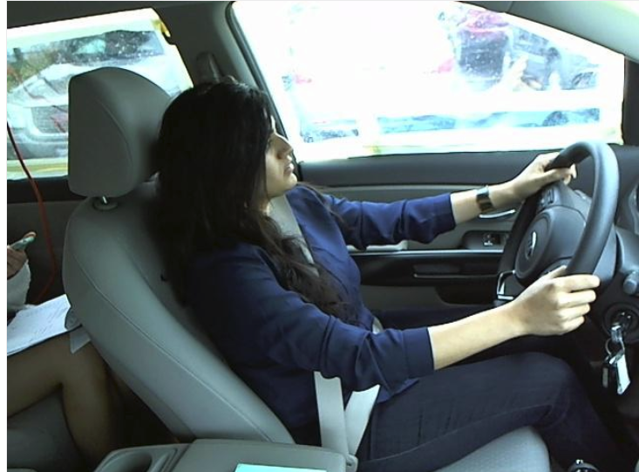
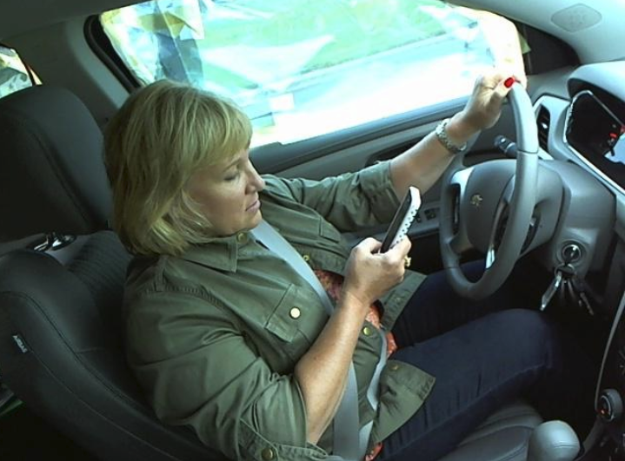
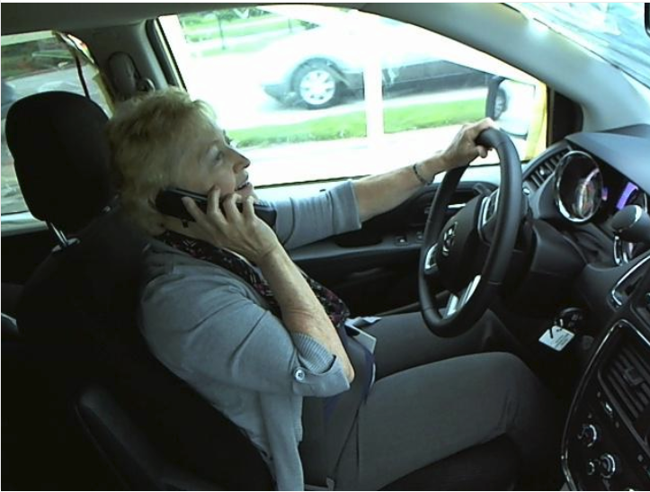
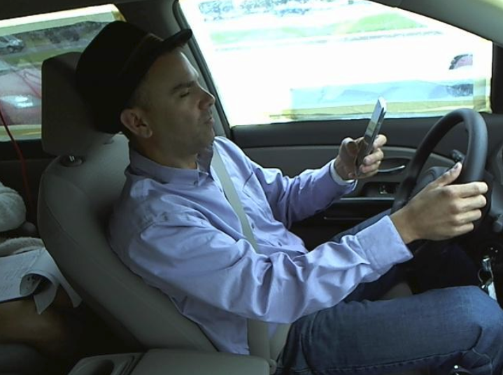
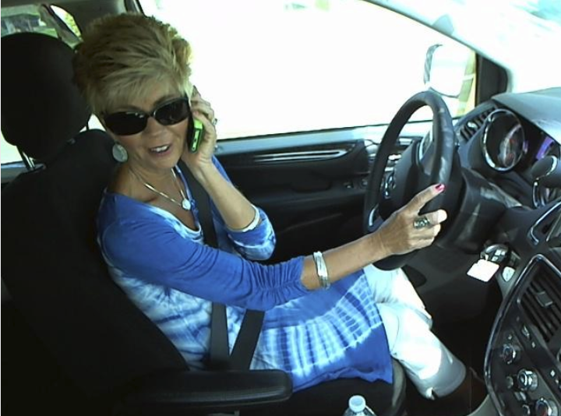
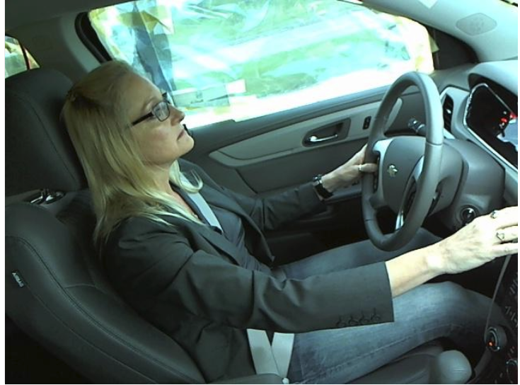
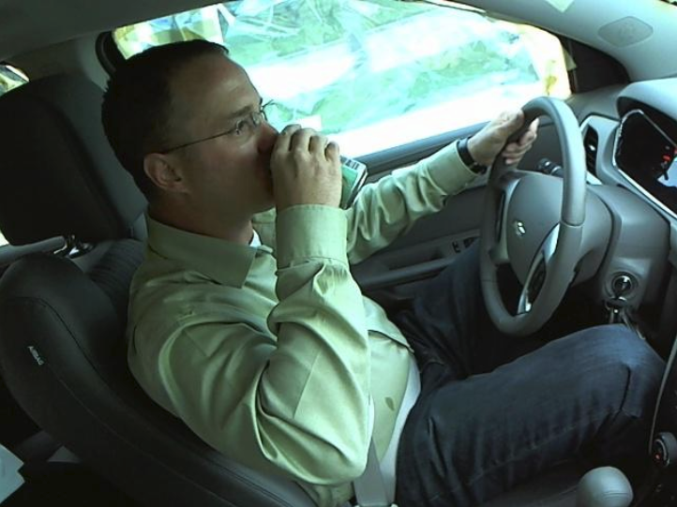
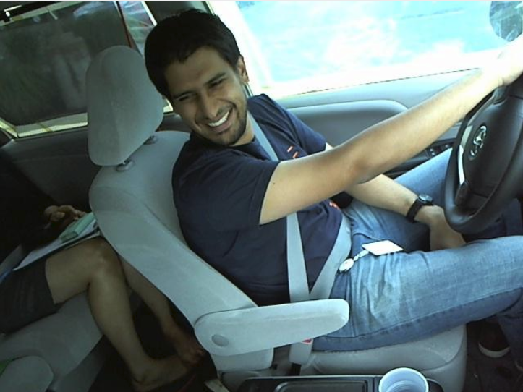
Images from each class

Slide 6
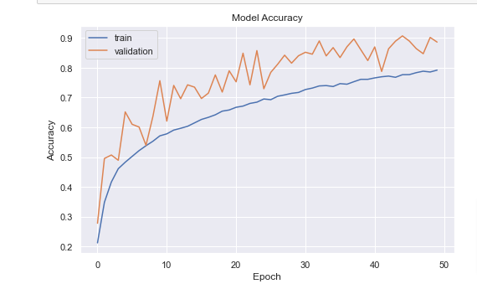
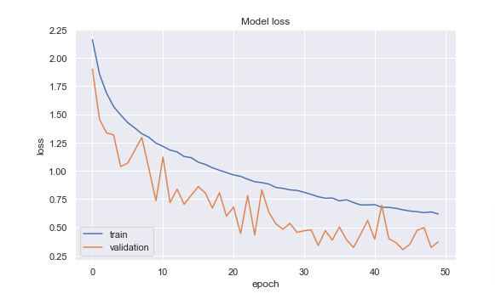
Transfer learning with VGG
VGG also takes into account the depth for image classification in a CNN
VGG consists of a sequence of con layers followed by a max pooling layer for spatial downsampling
We did not use the top fully connected layer in VGG instead placed our own dense layer with softmax activation and 10 classes to output.

Slide 7
Customizations for our models
VGG16
We used VGG with imageNet weights for feature extraction
Image augmentation (height shift, width shift, rotation)
Dropout layers (0.5)
Optimizer (Adam)
Activation (ReLu)
CNN
Optimizer (rmsprop)

Slide 8
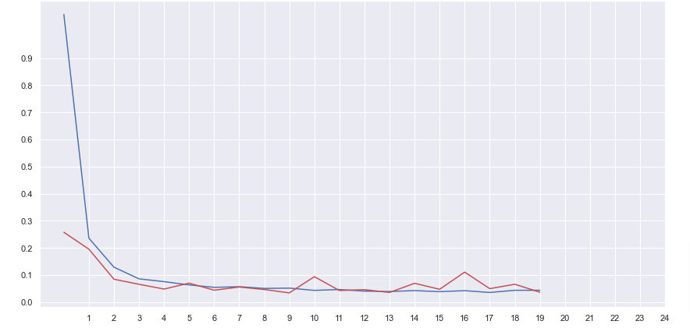
Training loss vs Accuracy Loss for CNN
Training Loss vs Accuracy Loss:

Slide 9
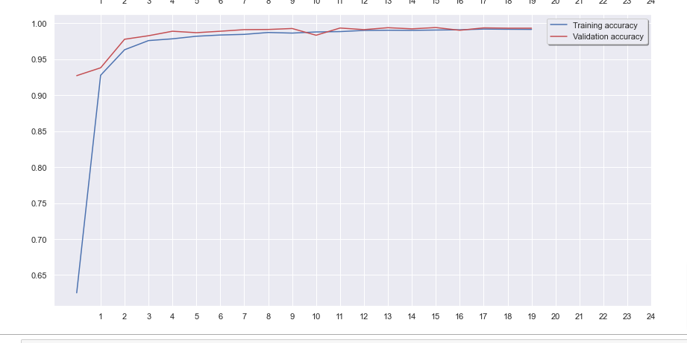
Training Accuracy vs Validation Accuracy

Slide 10
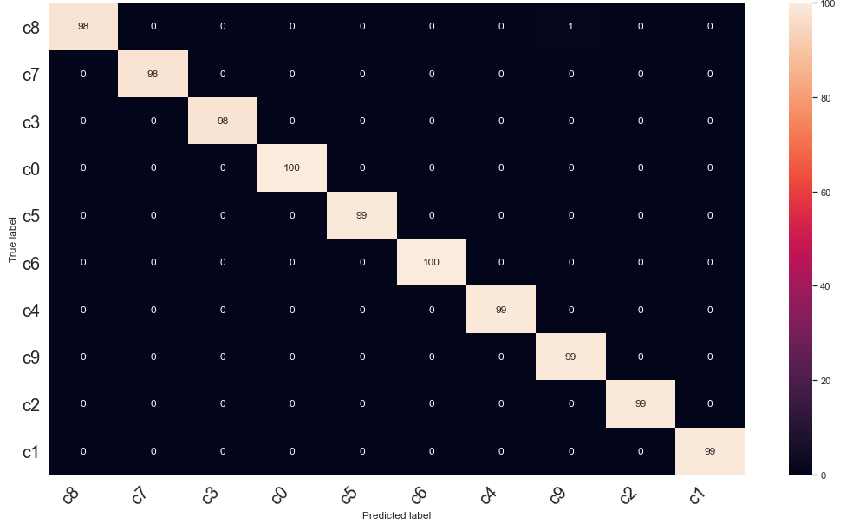
Confusion Matrix

Slide 11
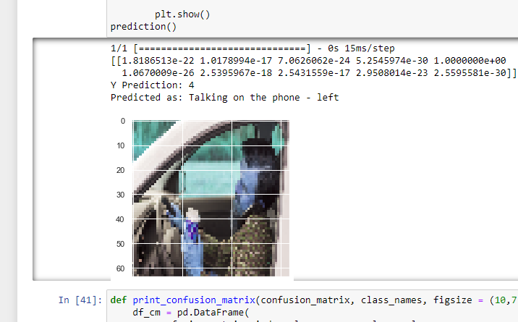
Testing CNN using random images:

Slide 12
Other experiments
EfficientNet
VGG
CNN (with tweaks in hyperparameters)

Slide 13
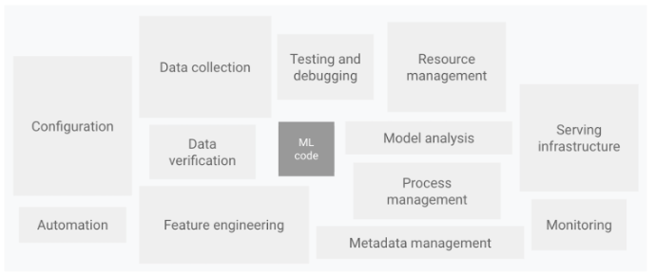
Machine learning pipeline using Apache Airflow
As we know - An ML pipeline facilitates us to run all the steps of an ML system, starting from data collection to model deployment and serving.
We used Apache Airflow as our ML pipeline orchestrator

Slide 14
Apache Airflow
Airflow offers a beautiful UI to monitor, schedule and manage our workflows.
Airflow pipelines are defined in Python making it easier to use.
Airflow uses a concept of DAG which is a collection of all the tasks we want to run and is organized such that they reflect their relationships and dependencies.

Slide 15
Learnings and improvements
Model training on image data
Tensorboard integration with model training
Understanding how MLOps using Airflow works.
Experimenting with different models and testing our predictions
The use of transfer learning and using pretrained models
As part of improvements, we will be working on getting more accurate inferences.
Writing more advanced ml pipelines for airflow DAGs
Understanding other MLops frameworks and how to use them

Slide 16
Thank you!

